Slide 1
RLMO Round Table Meeting
Update on CEEMS AG activities
Ian Dunmill
Assistant Director, BIML

Slide 2
CEEMS AG work since 55th CIML Meeting
Publication of the Revision of D 1 National metrology systems – Developing the institutional and legislative framework
Current projects
Revision of D 14 Training and qualification of legal metrology personnel
Revision of D 19 Pattern evaluation and pattern approval
New publication on Application of online technology to capacity building and other CEEMS activities
e-Learning – developing new strategy and content
OIML CEEMS Award 2021 – nominations received from three regions. Winner to be announced at CIML Meeting

Slide 3
Application of online technology to capacity building and other CEEMS activities
Chapter 1: Introduction
Chapter 2: Technical Work - Developing documents and materials aimed at CEEMS community
Chapter 3: E-Learning
Chapter 4: Delivering Inter-Active Training courses
Chapter 5: Delivering consultancy and advisory support to the CEEMS community
Chapter 6: Maintaining contacts across the metrology world
Chapter 7: Engagement outside the metrology world
Chapter 8: Technological Issues

Slide 4
e-Learning and other online training
No in-person training courses due to pandemic
New Task Group on online training
Updating existing OIML e-Learning platform
New development server, software updates
New OIML website page on online training
Links to online learning available elsewhere

Slide 5
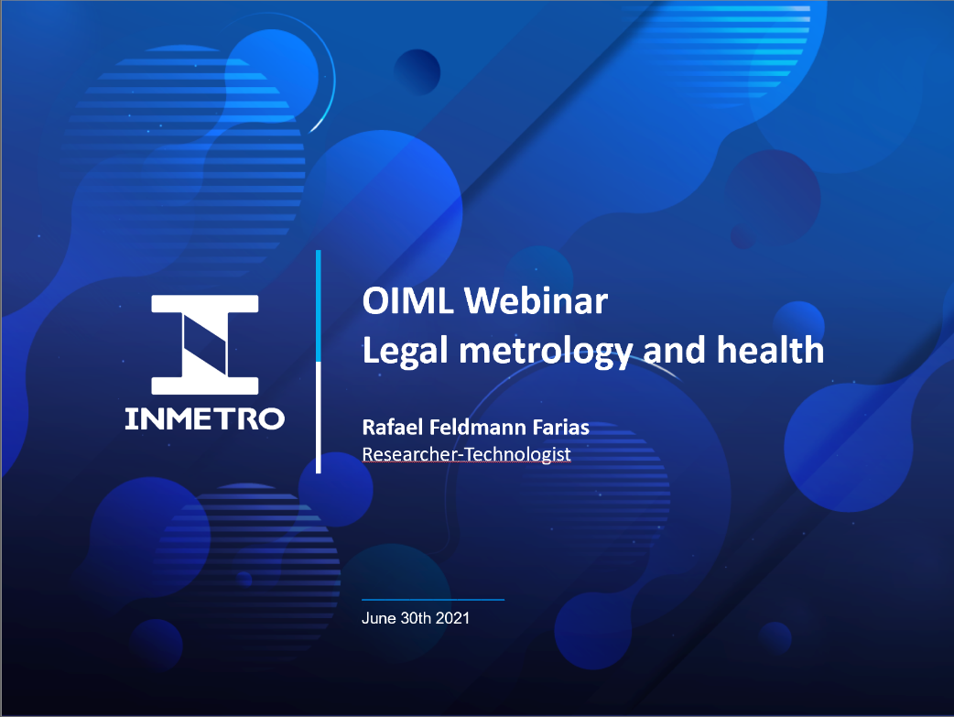
New online training initiative
Regular one hour webinars on single metrology topic
One speaker
Question and answer session
Video will be posted on OIML website
First webinar 30 June – medical devices
Suggestions welcome for future events

Slide 6
Task Group on medical devices with a measurement function
Meeting held in April 2021
Resulted in new project proposals on
Infrared medical thermometers
Verification of sphygmomanometers
Pulse oximeters? (suggested but no convener identified)
Survey on regulation of medical devices to be conducted soon

